Slide 1

Pull Up / Muscle Up Workshop
Pechi und Steph

Slide 2
Zeitplan
Einleitung (20min)
  Progression Video (10min)
Warm Up (40min)
Pull Up (60min)
  Strict
  Kipp
  Butterfly
Break (10min)
  Progression Video (10min)
Muscle Up (60min)
  Bar
  Ring

Slide 3
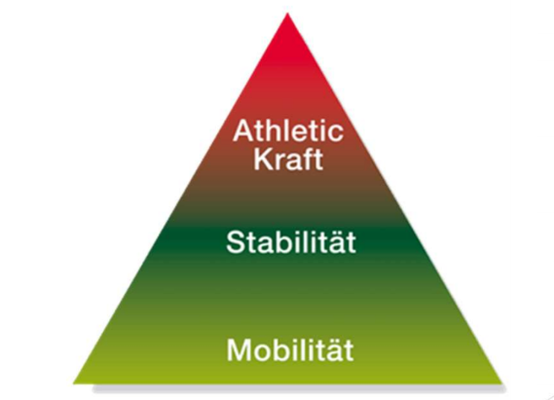

Einleitung
Notes:
Therorie
Vorraussetzung
Probleme
Video

Slide 4
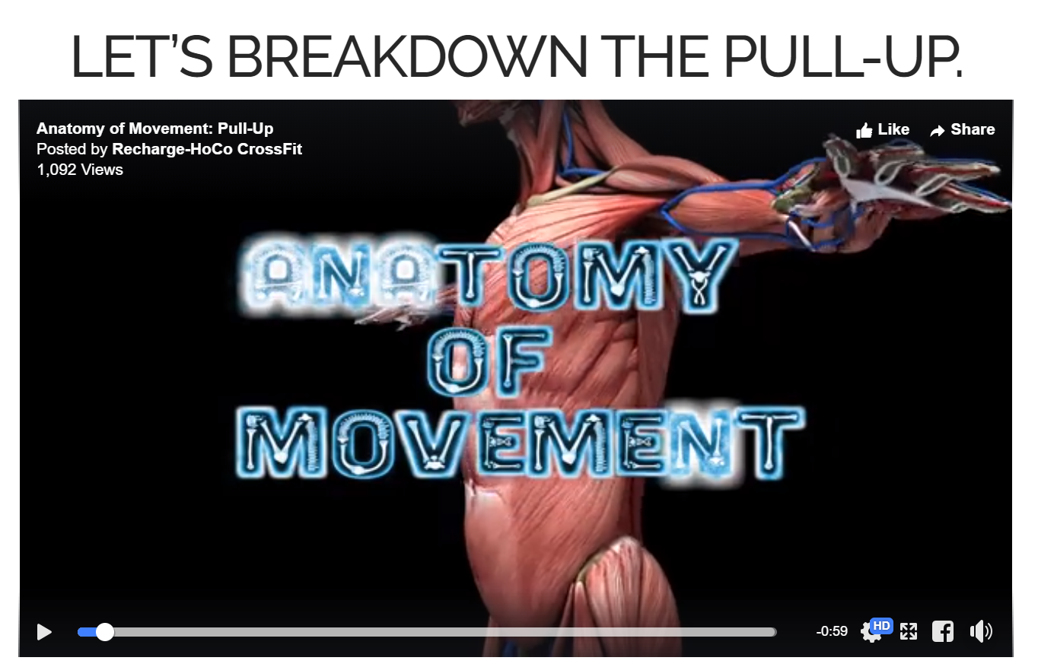
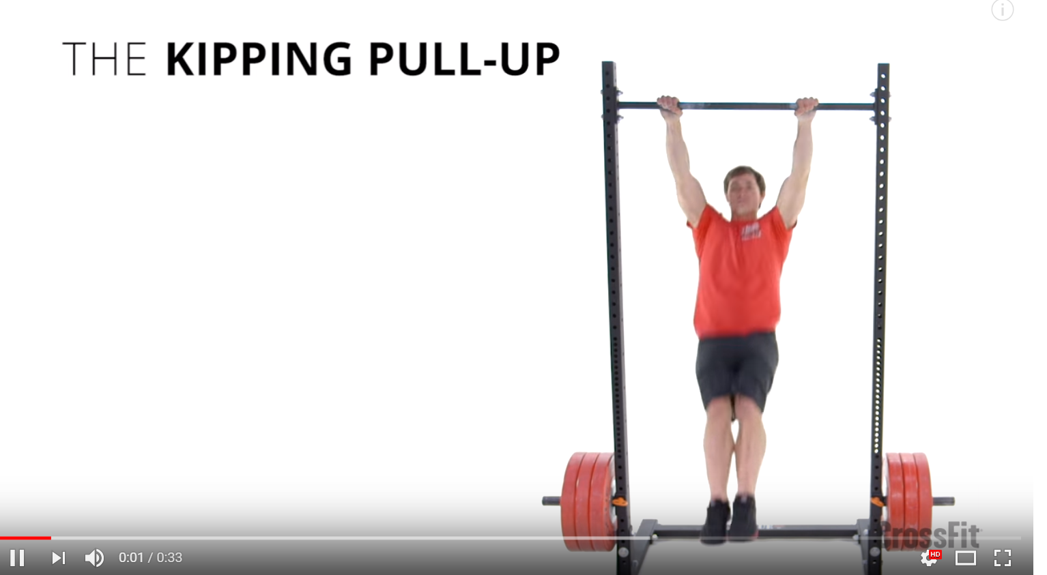
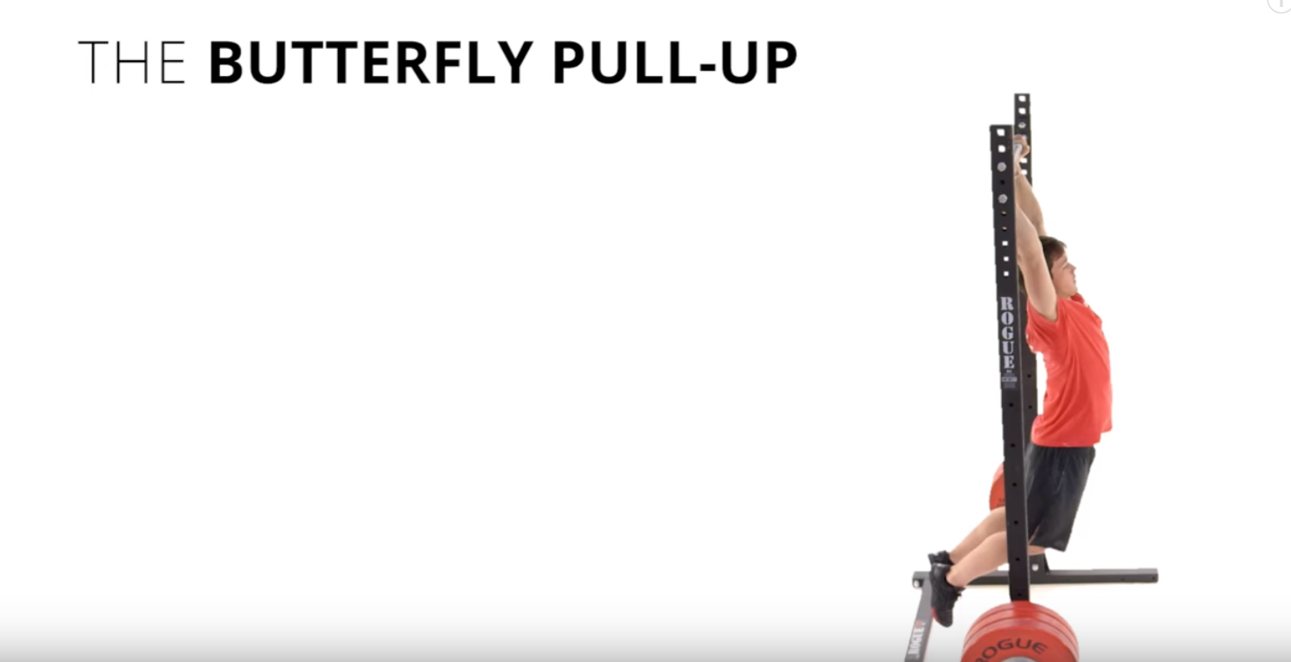
Progression Video
Pull Ups
Notes:
Therorie
Vorraussetzung
Probleme
Video

Slide 5
Practise
Progressions
with Video before and after
Notes:
Therorie
Vorraussetzung
Probleme
Video

Slide 6
WOD
8 Rounds of
Your hardest Progession with proper Form
5 reps every 20 sec
If you fail do 1 reps less
Notes:
Therorie
Vorraussetzung
Probleme
Video

Slide 7
BREAK - 10min
Notes:
Therorie
Vorraussetzung
Probleme
Video

Slide 8
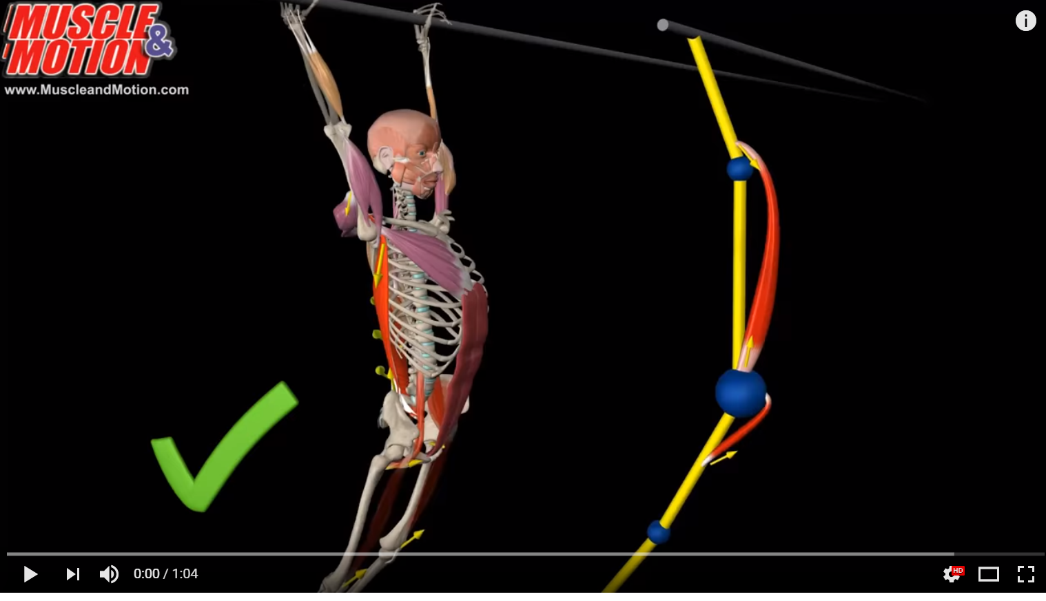
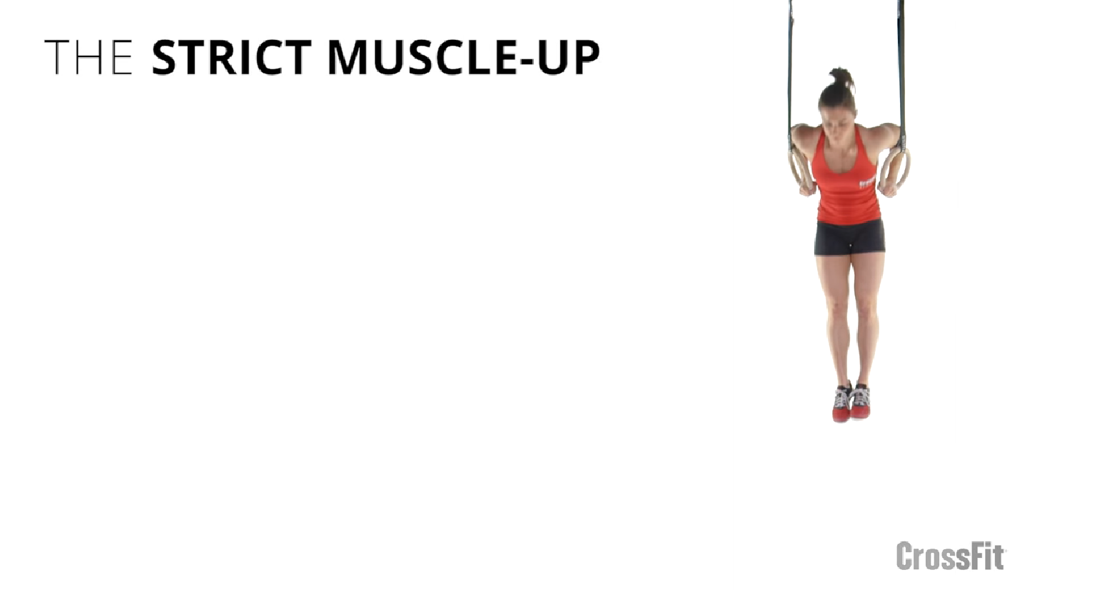
Movement
Muscle Ups
Bar
Ring
Notes:
Therorie
Vorraussetzung
Probleme
Video

Slide 9
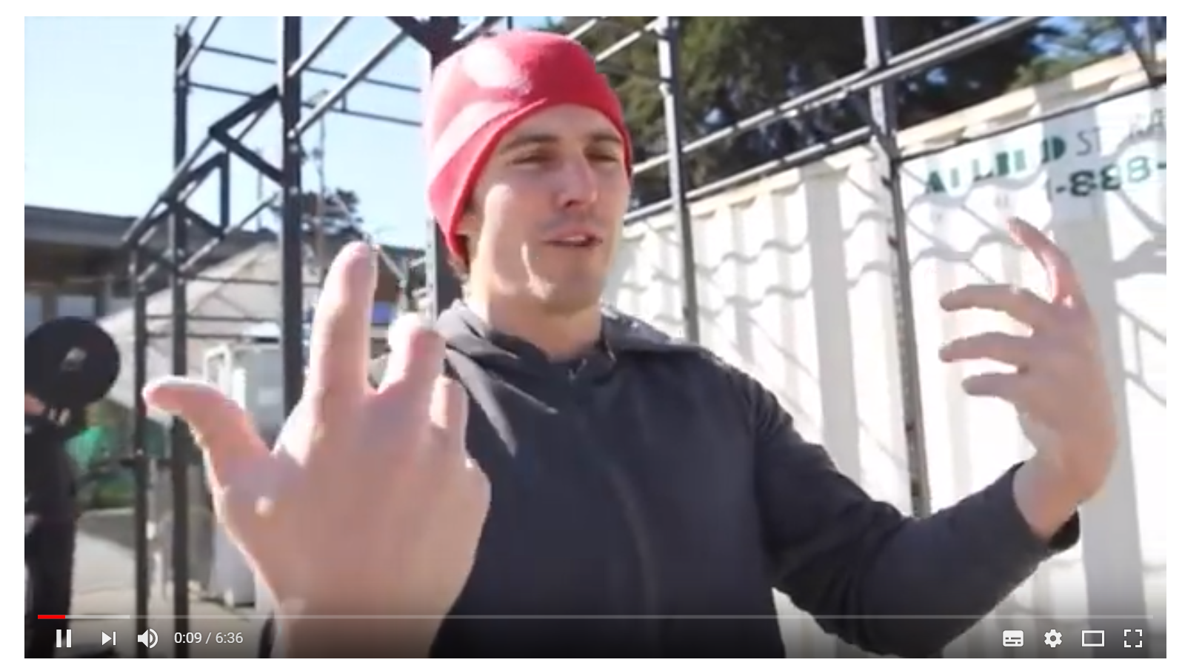
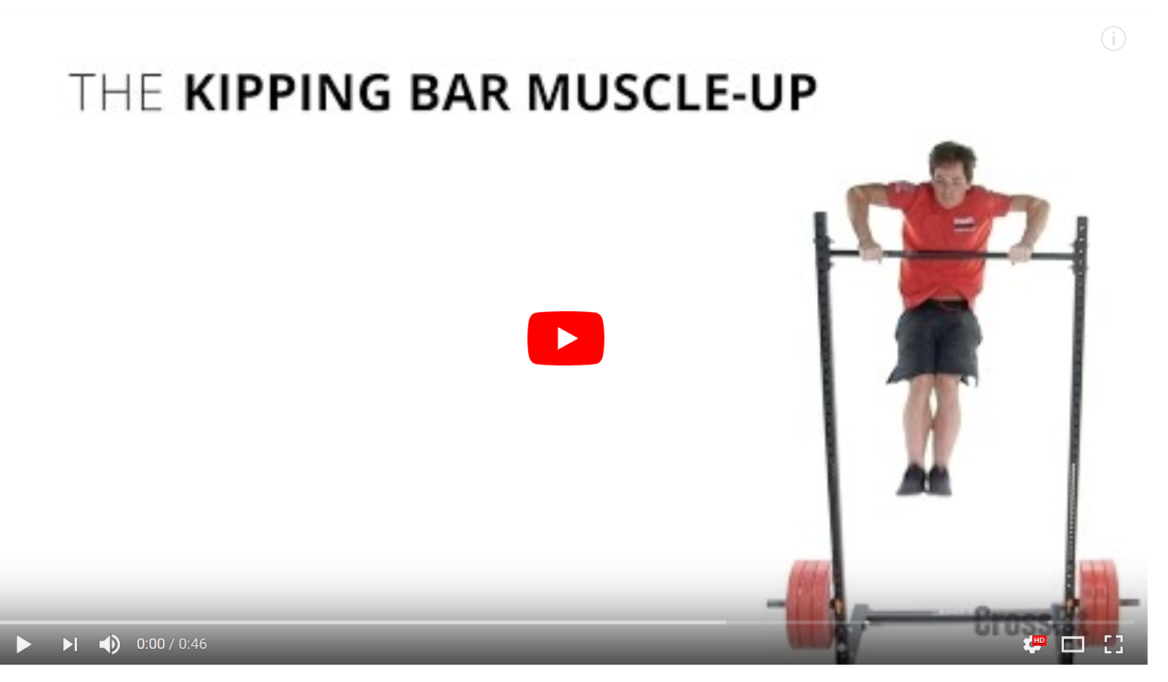
Progression Video
Bar Muscle Ups
Ring Muscle Ups
Notes:
Therorie
Vorraussetzung
Probleme
Video

Slide 10
Practise
Progressions
with Video before and after
Notes:
Therorie
Vorraussetzung
Probleme
Video

Slide 11
Danke
Notes:
Therorie
Vorraussetzung
Probleme
Video

